Slide 1

Basic Details of the Team and Problem Statement
Ministry : National Disaster Response Force (NDRF)
PS Code: GS 902
Problem Statement Title: Effective Under Water Search/ROV
Team Name: Super 6
Team Leader Name: Maaz Shahid
Institute Code: C-6198
Institute Name: Techno International New Town
Theme Name: Disaster Management

Slide 2
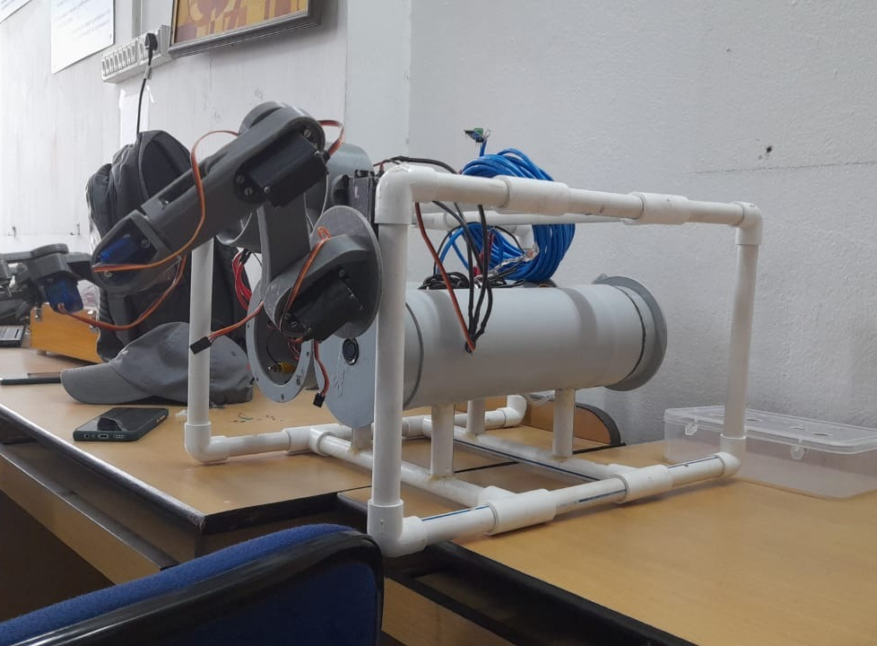
Idea/Approach Details
Tech Stack :
2x 12V 3S 2500 mAh Samsung INR 18650 25R Li-ion battery.
3x Ducted Brushless motor.
3x Brushless Electronic Speed Controller
3x MG90/6x MG995 Servo
1x HD camera
1x Arduino Nano.
1x Arduino Uno
1x JSN-SR04T Ultrasonic Sensor
1x 16ch PCA9685 servo controller module
2x MAX485 TTL TO RS485 conversion module
Remotely Operated Underwater vehicles or ROV’s are Underwater Robots that are used to interact with the underwater environment. These robots are designed to operate in places where it is dangerous or not accessible for divers to go for physical inspections or give information about the location pre dive session. Thus, a ROV is a required tool for search and rescue operations as well as in research, oil mining, and underwater filming. The robot is equipped with powerful sensors as well as dc brushless motors for steering as well as camera for live video footage. It transmits data to the base station via CAT6 internet cables using the RS485 module for minimal data losses and performs automated dive. The tilt control system, underwater dive and exploration are all controlled by Joysticks. The tools used in the developing process is Arduino (microcontroller) for reading and controlling all sensors data such as ultrasonic sensor and motor speed control in order to keep the vehicle stabilized and running.
Underwater ROV V1 for testing all electrical systems onboard.
V2 to be constructed acrylic and aluminum frames.

Slide 3
Idea/Approach Details
Use Cases:
Dependencies / Show stopper
ROVs are often used in search and rescue operations to find missing objects, humans, boats, ships, etc.
ROVs are used for different underwater works. Like, large ROVs are used in offshore oil and gas industries and small ROVs are used in water tank inspection, pipe inspection, wastewater treatment inspection, commercial diving, etc.
ROVs are used by different research institutes to study ocean from its coastal shallows to greatest depths.
ROVs are widely used in STEM(science, technology, engineering and mathematics) education and in different academic research works.
Operation depth range of up to 150m
Object Size Detection using Machine Learning
Accurate measurement using LIDAR and Ultrasonic sensor
Robotic arm for moving and retrieving small objects
High torque ducted motor
Viscous drag resistant design
Highly maneuverable
Long battery life with external power option
Easy to assemble and repair
Robust communication system

Slide 4
Team Member Details
Team Leader Name: Maaz Shahid
Branch (Btech) Stream (CSE) Year (II)
Team Member 1 Name: Pratham Choudhary
Branch (Btech) Stream (CSE) Year (II)
Team Member 2 Name: Pradyumn Choudhary
Branch (Btech) Stream (CSBS) Year (II)
Team Member 3 Name: Swarnadeep Karmakar
Branch (Btech) Stream (CSE) Year (II)
Team Member 4 Name: Baisali Roy
Branch (Btech) Stream (CSE) Year (II)
Team Member 5 Name: Akash Kotal
Branch (Btech) Stream (CSE) Year (II)
Team Mentor 1 Name: Nilanjana Adhikari
Category (Academic/faculty) Expertise (NLP/ML) Domain Experience: 14 Years

